Slide 1


Smart AI Intelligent Resource Management and Integration of the Intel Agilex FPGA in a Reconfigurable Cluster for High-Performance Computing
Samip Bhattarai and Pedro Casanova
15/07/2026

Slide 2
Introduction & Motivation
The Infrastructure Problem
Manual Allocation: Lack of a centralized control plane forces users to manually select hardware targets.
Concurrency Failures: Simultaneous job deployments to the same board cause bitstream corruption and crashes.
Restricted Scalability: Unoptimized routing prevents the seamless integration of mixed architectures
The Physical Impact
Silicon Waste: Routing modest tasks to the Agilex 7 wastes over 4,400 unused DSP blocks.
Energy Leakage: Forcing the 680 Gbps memory bus awake for tiny workloads creates dynamic and static power waste.
Queue Saturation: Flashing massive .sof files for minor tasks instantly stalls the server waitlist.
The Motivation
Intelligent Task Orchestrator: An agent that could look at an incoming task, understand limitations, and automatically route it to the best hardware in order to save time, power, and silicon.

Slide 3
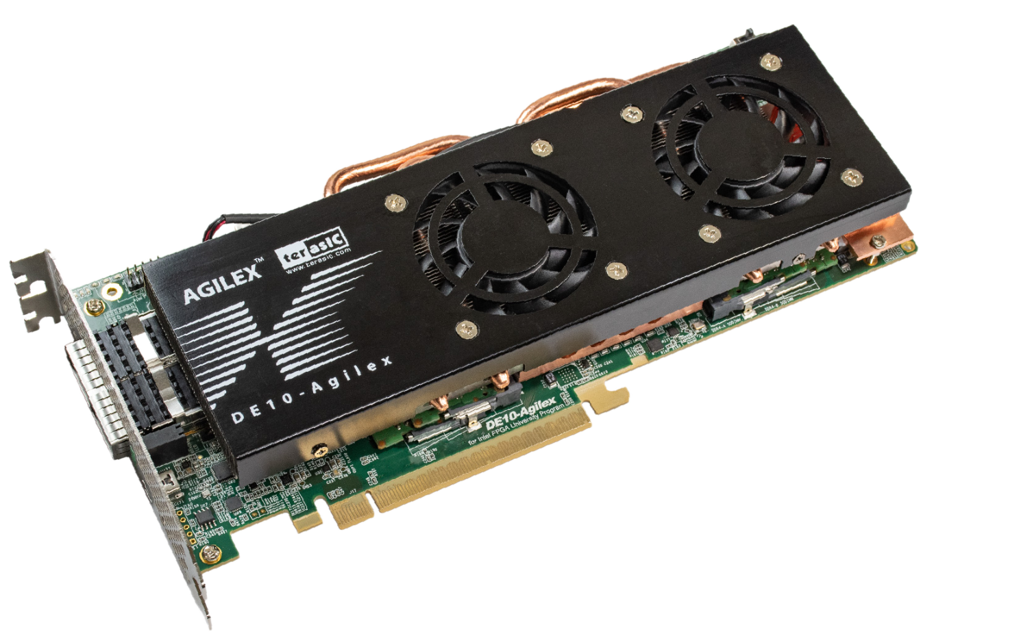

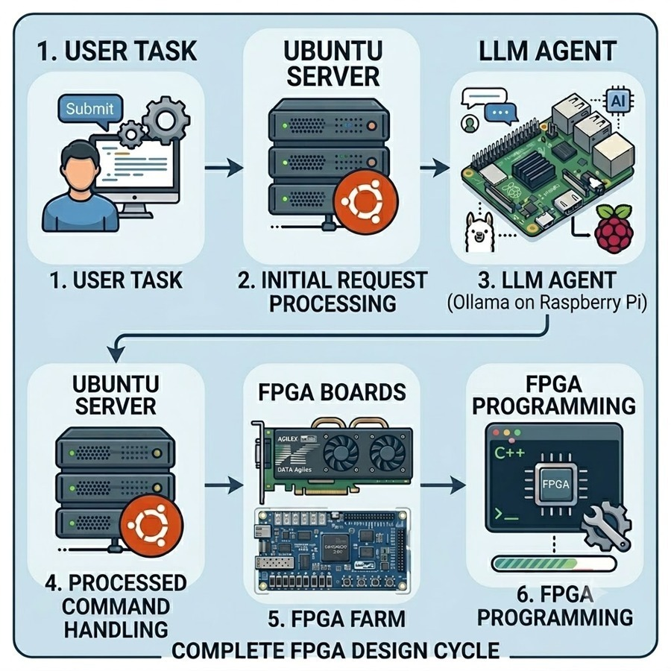
Project objectives
Contents
Integrate the Intel Agilex 7 (DE-10) Board: Establish the hardware architecture within a high-performance reconfigurable cluster.
Develop a Smart Task Orchestrator: Implement an AI-driven agent for dynamic routing and resource allocation.
System Integration and Verification: Conduct rigorous testing to validate the communication between the AI agent, the Ubuntu server, and the FPGA hardware.

Slide 4
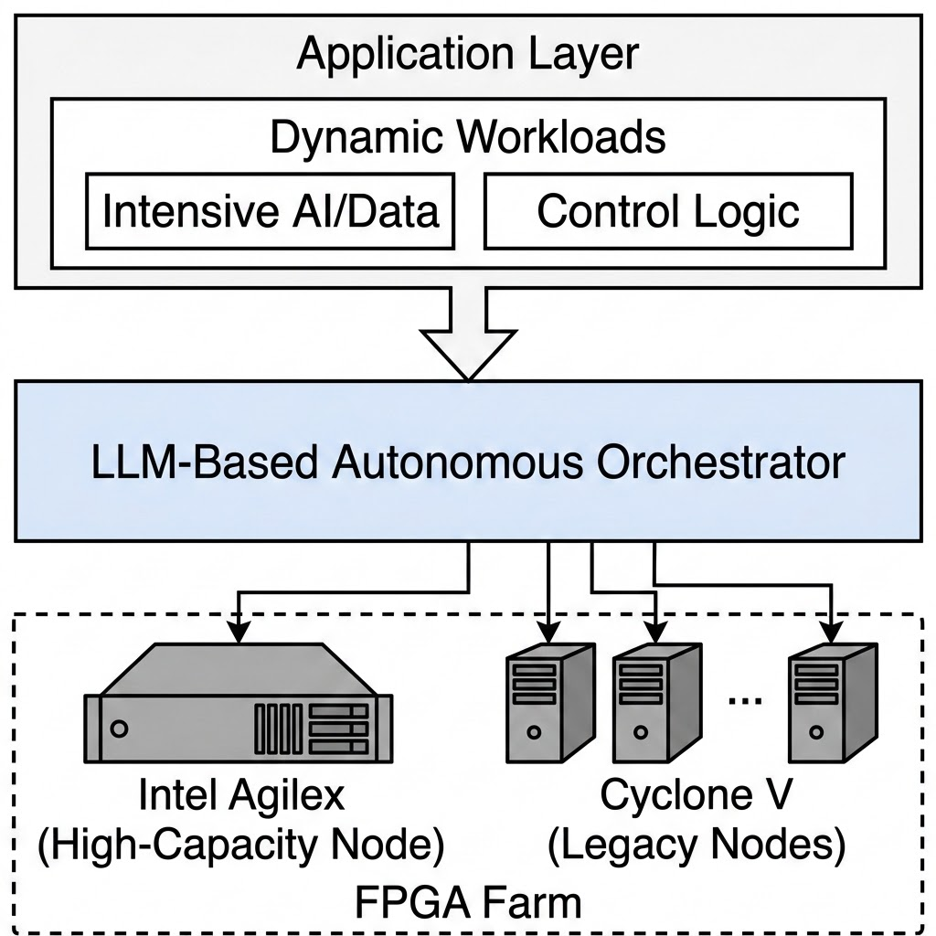
State of the Art
Reconfigurable HPC: FPGAs provide low-power, parallel acceleration for AI and data centers [1, 2].
Heterogeneous Farms: Modern clusters use multi-FPGA architectures and virtualization to share workloads [3].
The Integration Bottleneck: Integrating next-gen nodes (like Intel Agilex) into legacy infrastructures remains a critical challenge especially at scale.
LLM Orchestration: Autonomous AI agents can interpret parameters and dynamically assign workloads without manual intervention [4].
Proposed Solution: Deploying an LLM to autonomously route intensive logic to the Agilex and lighter tasks to Cyclone V boards.
[1] J. Peltenburg, J. van Straten, M. Brobbel, Z. Al-Ars, and H. P. Hofstee, “Generating high-performance FPGA accelerator designs for big data analytics with Fletcher and Apache Arrow,” Journal of Signal Processing Systems, vol. 93, no. 5, pp. 565–586, 2021.
[2] R. Wu, X. Guo, J. Du, and J. Li, “Accelerating neural network inference on fpga-based platforms—a survey,” Electronics, vol. 10, no. 9, p. 1025, April 2021. [Online]. Available: https://www.mdpi.com/2079-9292/10/9/1025
[3] W. F. Samayoa et al., “A survey on fpga-based heterogeneous clusters architectures,” IEEE Access, 2023.
[4] L. Wang et al., “A survey on large language model based autonomous agents,” Frontiers of Computer Science, 2024.

Slide 5
Methodology: AI Orchestrator Agent
Smart Queue Management
- Manages a waitlist of incoming tasks while the server is at maximum capacity
- Automatically cuts power to idle boards when the queue is empty to reduce energy waste.
Agentic Analysis
- A routing agent analyzes the .rpt file to classify the intended board.
- A gatekeeper agent reads verilog code to classify malicious intent and analyzes efficiency.
Centralized API
- The Flask based API handles the workflow between remote connections and the physical lab.
- Automates board assignment and tracking.

Slide 6
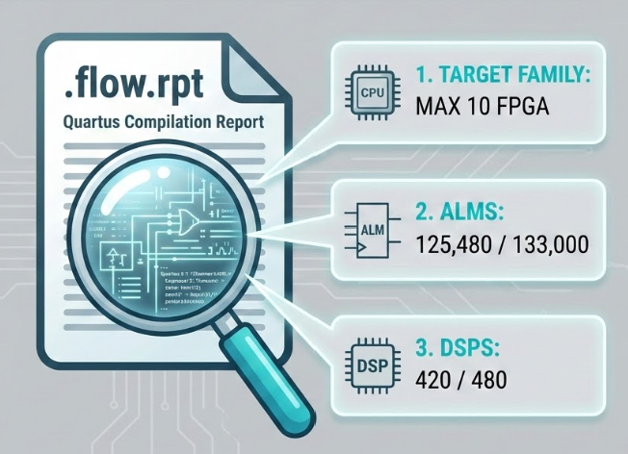
Methodology: Automated Resource Profiling
Pre-Deployment Processing:
The client parses the project's compilation reports locally on the user's machine.
Data Extraction:
Resource allocation data such as ALM count, DSP block utilization, and Target Family are pulled from the .flow.rpt file. Icarus Verilog is used to analyze the raw verilog code.
Information Bundling:
Locally extracted data gets packaged as a JSON and Verilog payload.

Slide 7


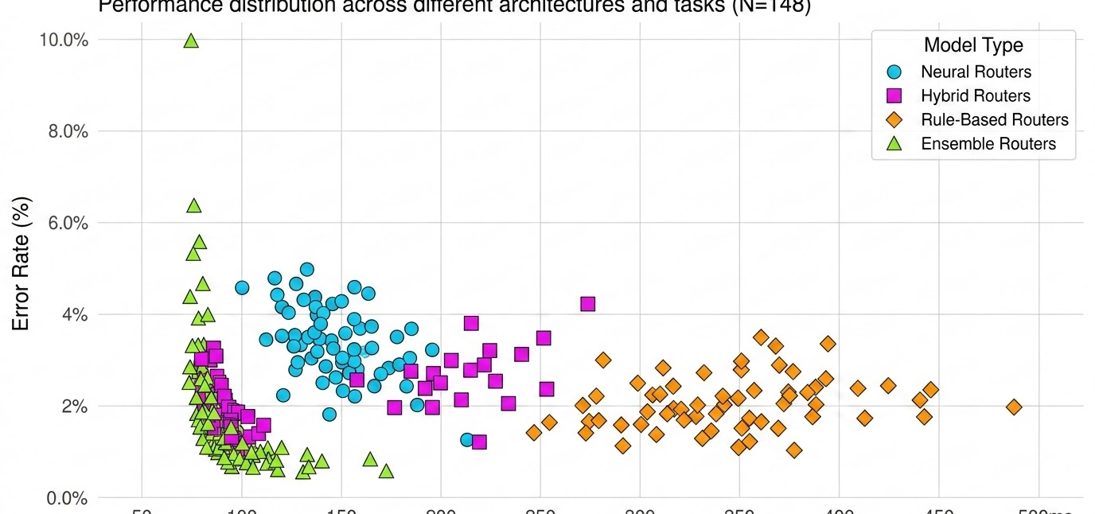
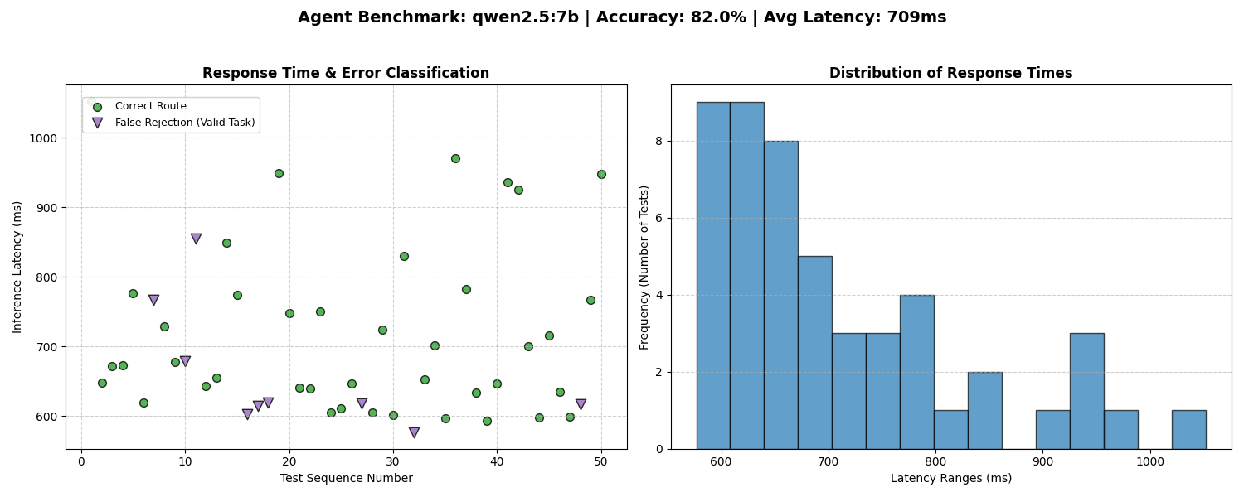

Methodology: AI Orchestrator Testing & Validation
Synthetic Data Generation
A custom Python script procedurally generated diverse .flow.rpt files representing multiple FPGA target families and logic capacities.
Python Data Gen
LLM Routing Agent
Prompt Refinement
Answer Validation
Edge Case Injection
Invalid and out-of-bounds compilation reports were intentionally created to stress-test the agent's constraints and trigger controlled rejections.
Response Time & Error Classification
Automated Answer Validation
The testing framework programmatically verified routing accuracy by cross-referencing the LLM's output against the known target family of the synthetic .flow.rpt.
Iterative Prompt Engineering
The error classification results drove iterative updates to the system prompt, transitioning the model from list-based rules to strict, step-by-step algorithmic evaluations.

Slide 8


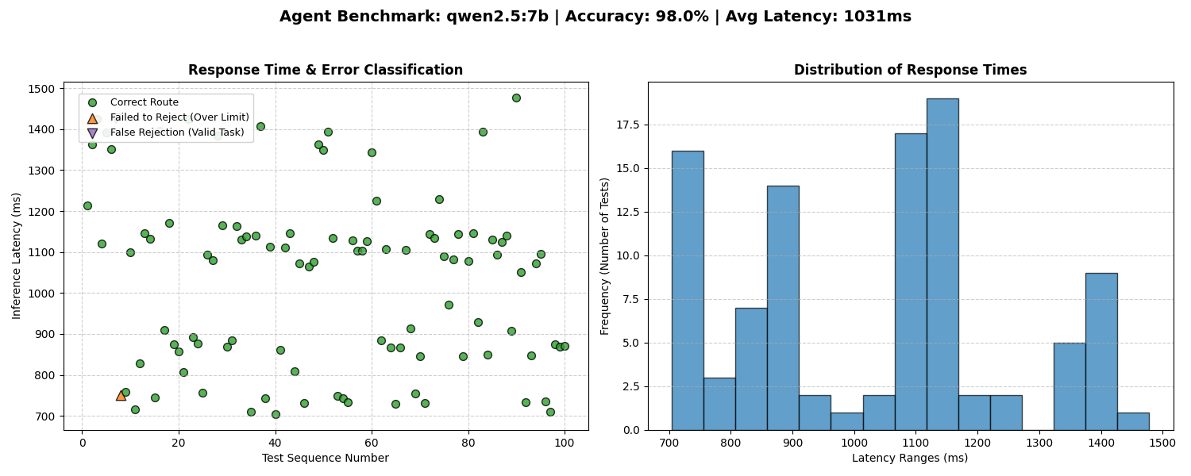

AI Performance & Optimization Metrics
Qwen 2.5 (7B Parameters)
Chose an open sourced general purpose model for its speed and accuracy.
Routing Accuracy (98%)
Mix of synthetic and real .flow.rpt files were tested on the model to correctly categorize hardware limits, route tasks, and run safety and efficiency evaluations.
Average Response Time (1031 ms)
A general purpose model was quicker in response compared to a deep reasoning model.

Slide 9

Results (Video)

Slide 10
Challenges & Reflection
timer
Testing Bottleneck
The Problem: Initially, validating the LLM agent required manually compiling dozens of full Quartus projects, consuming massive amounts of time.
The Solution: Pivoted to a synthetic testing model by writing a Python script to instantly generate fake .flow.rpt files for rapid AI benchmarking.
security
Hardware Security
The Problem: The Agilex 7 features a strict Secure Device Manager (SDM) that blocked deployments without precise Voltage Identification (VID) handshakes over PMBus.
The Solution: Used Altera's SystemBuilder to automatically generate the VID assignments.
dns
API Stability
The Problem: The Flask API was executed as a standard Python script, which caused the routing server to unexpectedly shut off.
The Solution: Reconfigured the environment to run the API as a dedicated background service to ensure 24/7 avalability.
lightbulb
Reflection: Ecosystem Transition
Transitioning from AMD Vivado to Intel Quartus required deeper upfront literature review.

Slide 11
Knowledge & Skills Acquired
memory
psychology
dns
security
EDA Tools & Hardware
- Gained proficiency in Intel Quartus
- Use cases for De1-SoC boards and the De-10 Agilex board
- FPGA Industry
AI & Prompt Engineering
- Optimization of an AI with limited resources
- Engineered strict system prompts to provide Deterministic Output
- Designed algorithmic safety guardrails to ensure Edge Case Management
API & Backend Architecture
- Built a functional API on a live server
- Designed an automated waitlist system that tracks and manages FPGA boards in real-time
- Built a security layer for the FPGAs on the farm
Secure Protocols
- Worked with remote data transfers utilizing OpenSSH, NetBird VPN, and SFTP.
- Built a system design to protect against dangerous IP usage on the Agilex 7

Slide 12




Future Work
Profile Matching
Auto Configuration
Security
Extracted data (e.g., PCIe Gen4 x16, DDR4) is queried against a database of available development kits (iWAVE, Arrow)
Upon hardware selection, the system automatically generates target-specific Quartus assignments (.qsf)
Scrape Top level file to detect all IPs that are being used in order to analyze signals and malicious intent

Slide 13
Basic Security Workflow
Top Level Source - Verilog
Stage 1: Structural Analysis
AST Analysis (deterministic)
Failed Parse
Blocked
pass
Hits Blocklist
Blocked
Stage 2: IP Detection
allow/deny policy
Review Required
Ambiguous
pass
Stage 3: LLM Review
Receives structured data to make decisions
Decision made
route_task()

Slide 14



Conclusions & Project Significance
02 / LLM Usage
AI Optimization Realized: Proved that strict prompt engineering on limited-resource edge devices drastically improves routing accuracy (98%) and system safety.
done
explore
01 / Foundation
Objectives Achieved: Successfully integrated the Agilex 7 and deployed a reliable, live control plane to eliminate hardware collisions and resource waste.
psychology
03 / Direction
The Future Roadmap: The infrastructure is now validated. The next steps are to integrate strict security protocols into the program to ensure safe usage of the FPGA Farm.

Slide 15



Thank You!
Pedro Antonio Casanova Martin
Samip Bhattarai

Slide 16
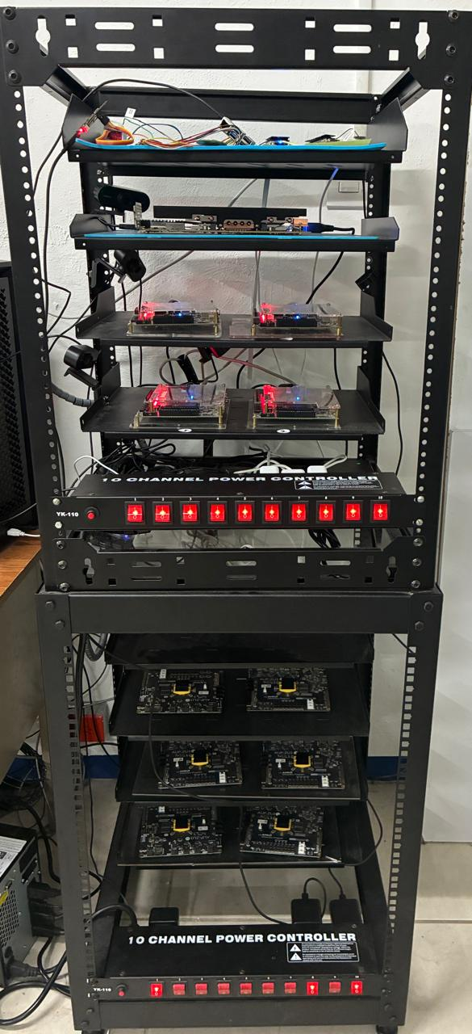
FPGA Farm Infrastructure
Potential Problems
HPC Hardware Bottleneck: Unoptimized job routing restricted overall high-performance computing capabilities.
Remote Control: No method of controlling FPGA Board remotely
Lacked centralized traffic control: Job routing and hardware status tracking were decentralized.
Inefficient Manual Allocation: Manually identifying and selecting boards resulted in boards being overridden.
Concurrency Failures: Simultaneous job submissions to the same hardware targets resulted in bitstream corruption and crashes.
Restricted Scalability: The integration of different FPGA board architectures were not supported.

Slide 17
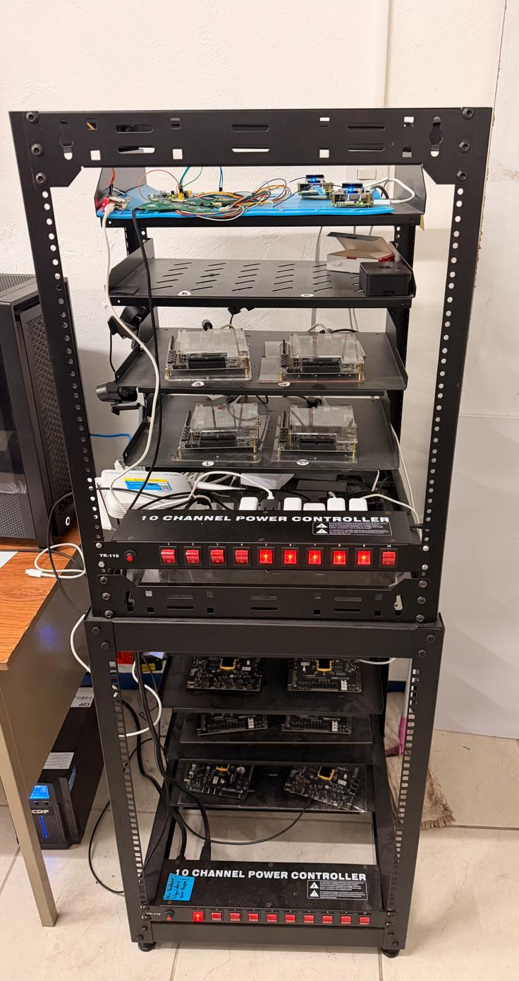
FPGA Farm Infrastructure
Pipeline
Potential Problems
Host Operating System: Ubuntu PC as a node
Network Access: NetBird VPN and OpenSSH
FPGA Programming: Utilizes Paramiko to execute remote Quartus commands
File Transfer: Compiled bitstream files scraped through Users directory and uploaded via SFTP protocol
HPC Hardware Bottleneck
Lacked centralized traffic control.
Users must manually choose for boards.
Simultaneous job deployments to the same board cause crashes and corrupted deployments.
No room for Scalability.

Slide 18
FPGA Boards on the farm
Specification | DE1-SoC (Cyclone V) | Agilex 10 (HPC Node) | The System Impact
Logic Capacity | ~32,000 ALMs | 1,000,000+ ALMs | Static Power: Massive baseline static power leakage if Agilex is powered on for simple logic.
DSP BLOCKS | 87 DSP blocks | 4,510 DSP blocks | Resource Mismatch: Routing a task with modest DSP needs (<87) to the Agilex wastes over 4,400 unused multiplier blocks silicon and power committed for no computational gain.
On-Board Memory | 64MB SDRAM | 32GB DDR4 (680 Gbps) | Dynamic Power: Wasted dynamic power keeping a massive 680 Gbps memory bus awake for tiny workloads.
Configuration Overhead | Tiny .sof file (1-2s JTAG flash) | Massive .sof file (Long JTAG flash) | Queue Saturation: Forcing the server to flash a massive Agilex bitstream for a tiny task instantly backs up the waitlist.
[1] Terasic Technologies, “DE-Agilex 10 User Manual,” 2023. [Online]. Available: https://www.terasic.com
[2] Terasic Technologies, “DE1-SoC User Manual,” 2023. [Online]. Available: https://www.terasic.com

Slide 19
FPGA AGILEX
Agilex 7 Setup Challenge
PMBus
SDM
Solution
Communication language for digital power regulation; enables precise Voltage Identification (VID) and stabilization of the power network..
System controller that mandates explicit Voltage Identification (VID) and security handshakes to initialize the FPGA and ensure operational integrity.
Altera’s SystemBuilder auto-generates necessary VID assignments to satisfy SDM requirements

Slide 20
AI Models
Prompt Engineering
Qwen 2.5 (7B Parameters)
Chose an open sourced general purpose model for its speed and accuracy.
System Prompting: The model needs a highly engineered "System Prompt" that acts as a strict rulebook for the AI to follow on every request.
Defining Constraints: The prompt explicitly defines the physical boundaries of the lab (e.g., DE-SoC maximums: 32,000 ALMs, 80 DSPs).
Edge Cases: Common edge cases are defined and the model is forced to output JSON format to catch any edge case errors.
Routing Accuracy (98%)
Mix of synthetic and real .flow.rpt files were tested on the model to correctly categorize hardware limits, route tasks, and run safety and efficiency evaluations.
Average Response Time (708 ms)
A general purpose model was quicker in response compared to a deep reasoning model.

Slide 21
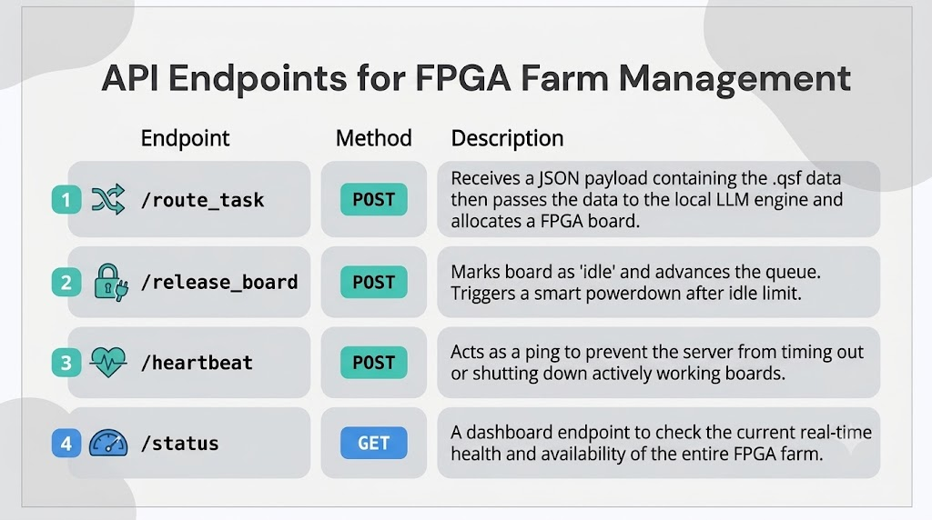

Slide 22
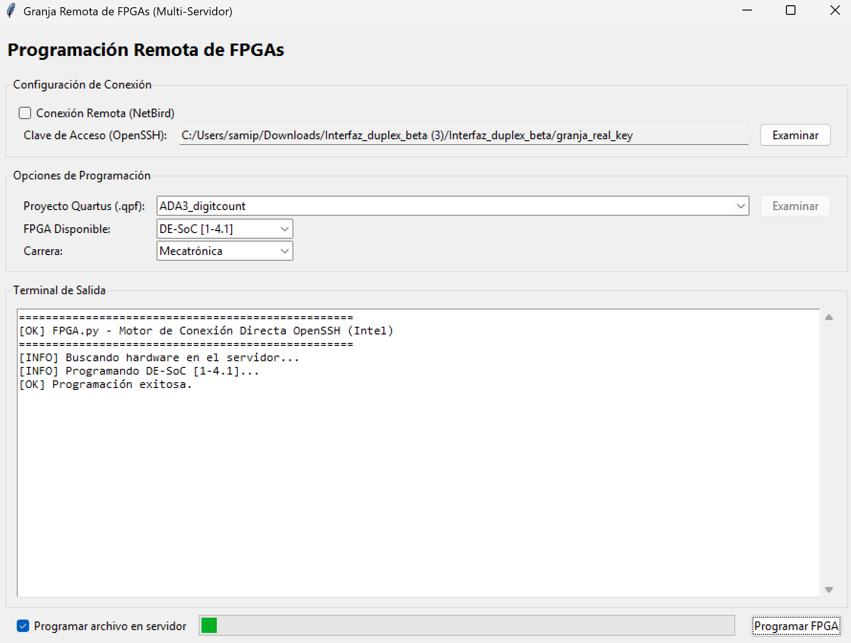
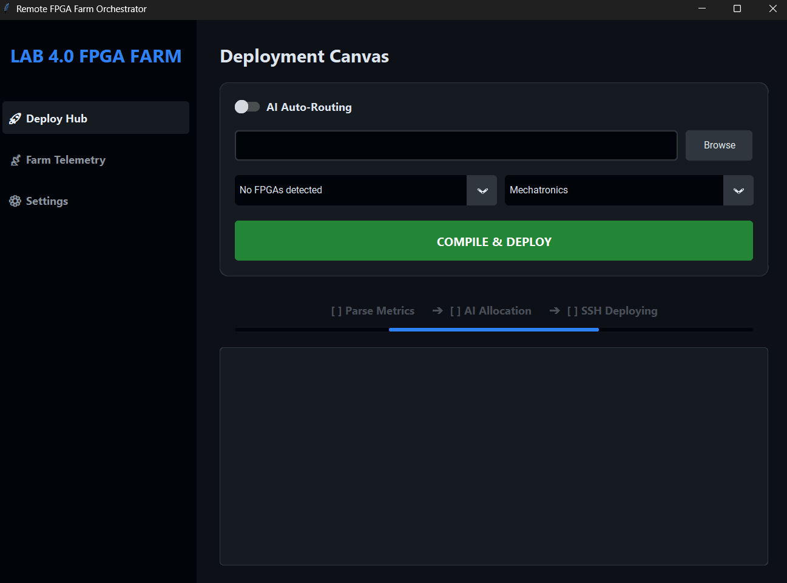
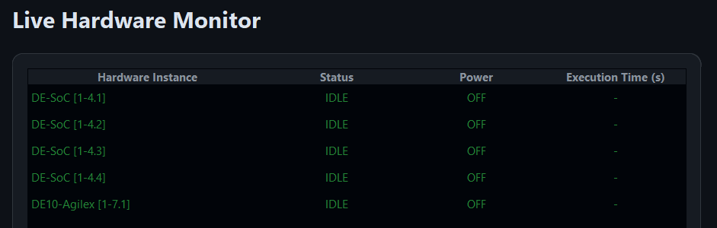
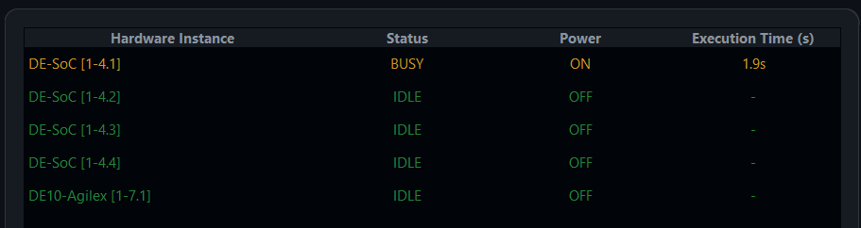
Results

